Slide 1
Network Analysis
Digital Humanities

Slide 2
Introduction
Network analysis explores relationships and connections within a dataset.
This sounds very techy, but network analysis can relate to digital and analog systems and projects.
While network analysis is used by a variety of fields in the Social Sciences and Life Sciences, Digital Humanists have used these tools to explore other kinds of networks.
The concept of a network has become ubiquitous in current culture.

Slide 3
Introduction
Almost any connection to anything else can be called a network, but properly speaking, a network has to be a system of elements or entities that are connected by explicit relations.
Unlike other data structures we have looked at–data bases, mark-up systems, classification systems, and so on—networks are defined by the specific relations among elements in the system rather than by the content types or components.
The term network is frequently used to describe the infrastructure that connects computers to each other and to peripherals, devices, or systems in a linked environment.

Slide 4
Network Examples
The networks we are concerned with in Digital Humanities are created by relationships among different elements in a model of content or unique project.
Good examples of networks are social networks, traffic networks, communication networks, and networks of markets or influence.
Many of the same types of diagrams are used to show or map these networks, and yet, the content of the relations and of the entities might be very different in each case.
Standardization of graphic methods can create a problem when the same techniques are used across disciplines and/or knowledge domains, so a critical approach to network diagrams is useful.

Slide 5
Types of Networks
Social networks are familiar and the use of social media has intensified our awareness of the ways social structures emerge from interconnections among individuals.
Actor-network theory, or ANT, is a contemporary formulation by Bruno Latour that extends developments in Sociology from early in the 20th century work of Georg Simmel (German Sociologist, Philosopher, and Critic) and others. ANT is a social theory where everything in the social and natural worlds exists in constantly shifting networks of relationship.
A network may or may not have emergent properties, may or may not be dynamic, and may have varying levels of complexity.

Slide 6
Types of Networks
Simple networks, like the connection of your computer to various peripheral devices through a wireless router in your home environment, may exhibit very little change over time, at least little observable change.
But, a network of traffic flow is more like a living organism than it is like a set of static connections.
Though nodes may stay in place, as in airline hubs and transfer points, the properties of the network have capacity to vary considerably.

Slide 7
Using Networks in Research
Networks exhibit varying degrees of closed-ness and open-ness, and researchers interested in complex or emergent systems are attentive to the ways boundary conditions are maintained under different circumstances, helping to define the limits of a system.
Social networks are almost never closed, and like kinship relations or communications, they can quickly escalate to a very high scale.
Epidemiologists trying to track the spread of a disease are aware of how rapidly the connections among individuals grows exponentially in a very short period of time.
Network analysis is an essential feature of textual analysis, social analysis, and plays a large role in policy and resources allocation, as well as in other kinds of research work.

Slide 8
Components of a Network
The basic elements of any network are nodes and edges.
In network analysis, we refer to objects as nodes or vertices, and usually draw them as points.
We refer to the connections between the nodes as edges, and usually draw them as lines between points.
The degree of agency or activity assigned to any node and the different attributes that can be assigned to any relation or edge will be structured into the data model.

Slide 9
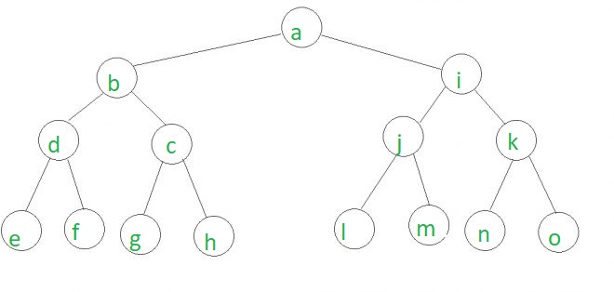
Sample Nodes and Edges Diagram

Slide 10
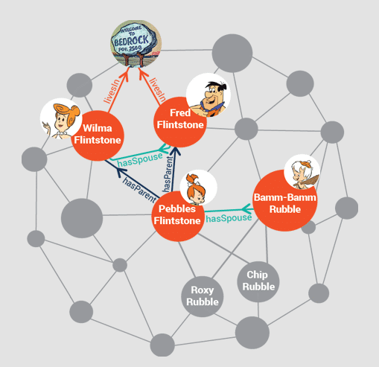
Data Models
The simplest data models for networks consist of “triples” – three part structures that allow entities to be linked by relations.
Example of a “triples” data model

Slide 11
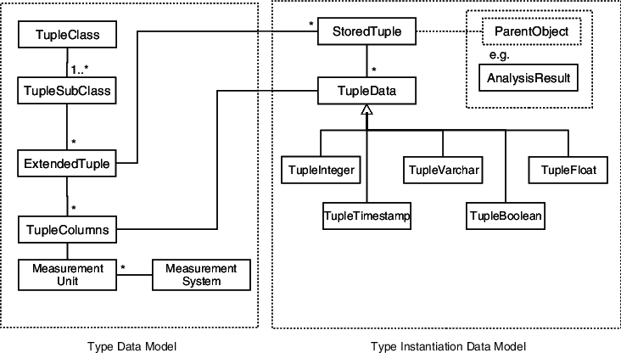
Data Models
This is very different in character from the “tuple” or two-part structure that links records and entities, for instance, in the use of metadata to describe an object.
Example of a “tuple” data model.

Slide 12
Exercise – Kindred Britain
Exercise: Kindred Britain (http://kindred.stanford.edu/)
This is a site that looks at the connections about 30,000 British individuals. The project is meant to show the many ways in which connections form through social networks, family ties, business and political circumstances. Play around on the site for a while and then we’ll discuss:
Selection of individuals
Character and quality of relations
Explicit assumptions and implicit ones
The diagrams and their rhetorical power

Slide 13
Advanced Network Theory
Advanced network theory pays attention to emergent properties of systems.
The capacity of networks to “self-organize,” using very simple procedures that produce increasingly complex results, makes them useful models for looking at many kinds of behaviors in human and non-human systems.
Networks do not have to be dynamic, systems almost always are. The study of systems theory and of networks is relatively recent, and only emerged as a distinct field of research in the last few decades.
We might argue, however, that novelists and playwrights have been observing social networks for much, much longer, as have observers of animal behavior, weather and climate, and the movements of heavenly bodies held in relation to each other by magnetism, gravity, and other forces.

Slide 14
Advanced Network Theory
Networks consist of nodes (entities) and edges (relations).
The data model for a network is a simple three-part formula of entity-relation-entity. This can be structured in a spreadsheet and exported to create a network visualization.
Networks emphasize relations and connections of exchange and influence. Refining the relations among nodes beyond the concept of a single relation is important, so is the change of relations over time.
Social networks change constantly, as do communication networks, and the relations among the technology that supports a network and the psychological, social, or affective bonds can alter independently.

Slide 15
Exercise
Exercise:
You can sketch a network on paper quite easily. Put yourself at the center and then arrange everyone you know in your immediate circles (family, friends, clubs, groups) around you.
Think about degrees of proximity and also connections among the individuals in different parts of your network.
How many of them are linked to each other as well as to you. If you can, code the lines that connect your various persons to indicate something about the relationship.
How does that change the drawing?
What attributes of a relationship are readily indicated?
Which are not?

